Slide 1
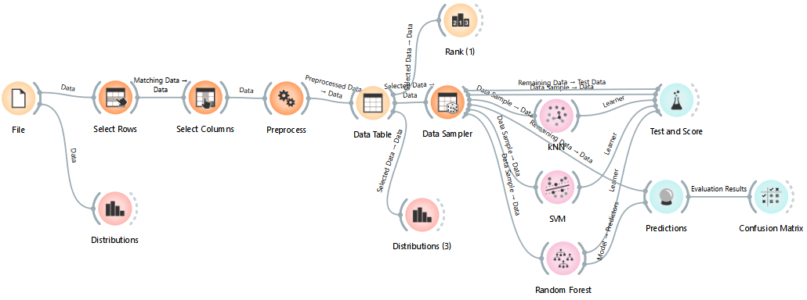
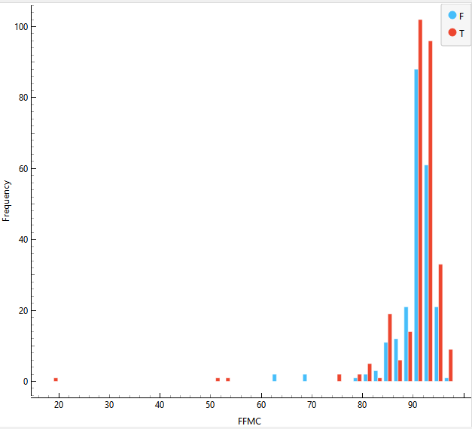
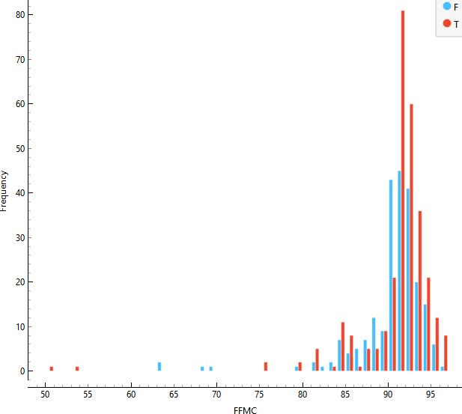
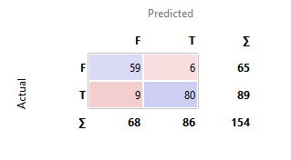
CSCU9M5 ASSIGNMENT
1. Student Number: 3455375
2. Project Methodology (CRISP-DM)
This project follows crisp-dm methodology. The steps carried out were:
Business Understanding: The aim of this project is to develop a predictive model that predicts whether the burned forest area is greater than 4%.
Data Understanding: The dataset contains 13 variables such as X, Y, month, day, FFMC, DMC, DC, ISI, temp, RH, wind, rain, and area. These data were loaded into orange and explored about data types, and distributions.
Data Preparation: Removed duplicates to avoid bias and redundancy, checked missing values, ensured all features were recognized properly, normalized variables, and split the dataset into 70% training and 30% testing using data sampler widget
Modelling: Selected 3 classification models for comparison such as kNN, SVM, and Random Forest. These models were trained using training data and tuned hyperparameters inside orange.
Evaluation: All the models were connected to test and score to check the performance. Metrics such as accuracy, AUC, precision, recall, and precision were used to predict the best model.
ORANGE WORKFLOW
3. Variables/ Data Understanding
Variable | Type (before) | Type (after one hot encoding) | Impact
Month | Categorical | Numerical | To detect seasonal fire, adding this feature may slightly help.
FFMC | Numerical | Numerical | Kept it because it has a moderate affect on fire spread.
DMC | Numerical | Numerical | Kept it because it can affect fuel moisture which is a factor of fire spread.
DC | Numerical | Numerical | It has high influence on effecting drought conditions.
ISI | Numerical | Numerical | It influences initial spread rate.
Temp | Numerical | Numerical | Higher temperature leads to higher fire risk.
RH | Numerical | Numerical | Low humidity cause higher burned areas.
Wind | Numerical | Numerical | It strongly affects fire spread.
Rain | Numerical | Numerical | High rain reduces fire risk.
Area (Target) | Categorical | Binary (0 or 1) | The target variable to be predicted.
4. Data Preparation:
In this step, irrelevant attributes were marked as ignored in feature selection. For this problem, attributes like x, y, and day were ignored as these didn’t contribute much to predict the burned area and they were ranked below. Outliers were found in FFMC (18.7) and rain(6.4) column, and they were removed using select rows. Categorical values were converted to numerical values for better model performance. Found 0 missing values in the dataset.
Here, the histograms of FFMC before cleaning and after cleaning is attached.
HISTOGRAM
Before cleaning After cleaning
After cleaning, the extreme low-value outliers in the FFMC have been removed. Before the shape was highly left-skewed with a long tail, now it became less skewed and unimodal
5. Model Training and Hyperparameters:
Three classification Models were used to predict the burned forest area. The models used were kNN, SVM, and Random Forest. Each models were trained on the prepared and cleaned dataset with only the selected features (after removing x, y, day). The target variable was area.
Model | Hyper Parameters | Validation and Metrics
kNN | No of neighbors (15), metric (Euclidean), weight (by distance) | 5- fold CV : Accuracy= 83.9% , F1= 84%
SVM | Cost (c)- 20, Kernel (RBF), numerical tolerance(0.001), iteration limit (150) | 5- fold CV: Accuracy= 83.4%, F1= 83.4%
Random Forest | No of trees (710), min samples per leaf (5) | 5- fold CV: Accuracy= 85.3%, F1= 85.4%
6. Final Model and Results:
After evaluating all the 3 models, based on CA and F1,
Random forest was the best performing model during validation. Random Forest was trained using the best hyper- parameters as setting no of trees to 710 , sample per leaf to 5, and choosing 5- fold cross validation.
CONFUSION MATRIX
The confusion matrix tells us how good a model predicts each class. From the picture we can clearly see that this model correctly predicted 59 false and 80 true cases with only 15 wrongly predicted cases (6+9). This shows the model performs consistently well and is able to distinguish the classes with high reliability.
7. Insight about data or Models gained:
The model is not biased as it predicts both the classes fairly well, with only few wrong predictions.
Random Forest shows which features influence predictions such as FFMC, ISI, wind, and temperature, making it informative about overall patterns. However it does not explain each prediction in detail.
Overall, the model is balanced, reliable and highlights key factors affecting burned area.
8. References
[1] https://orangedatamining.com/
[2] https://canvas.stir.ac.uk/courses/18089/pages/a-worked-example?module_item_id=933461

